Slide 1
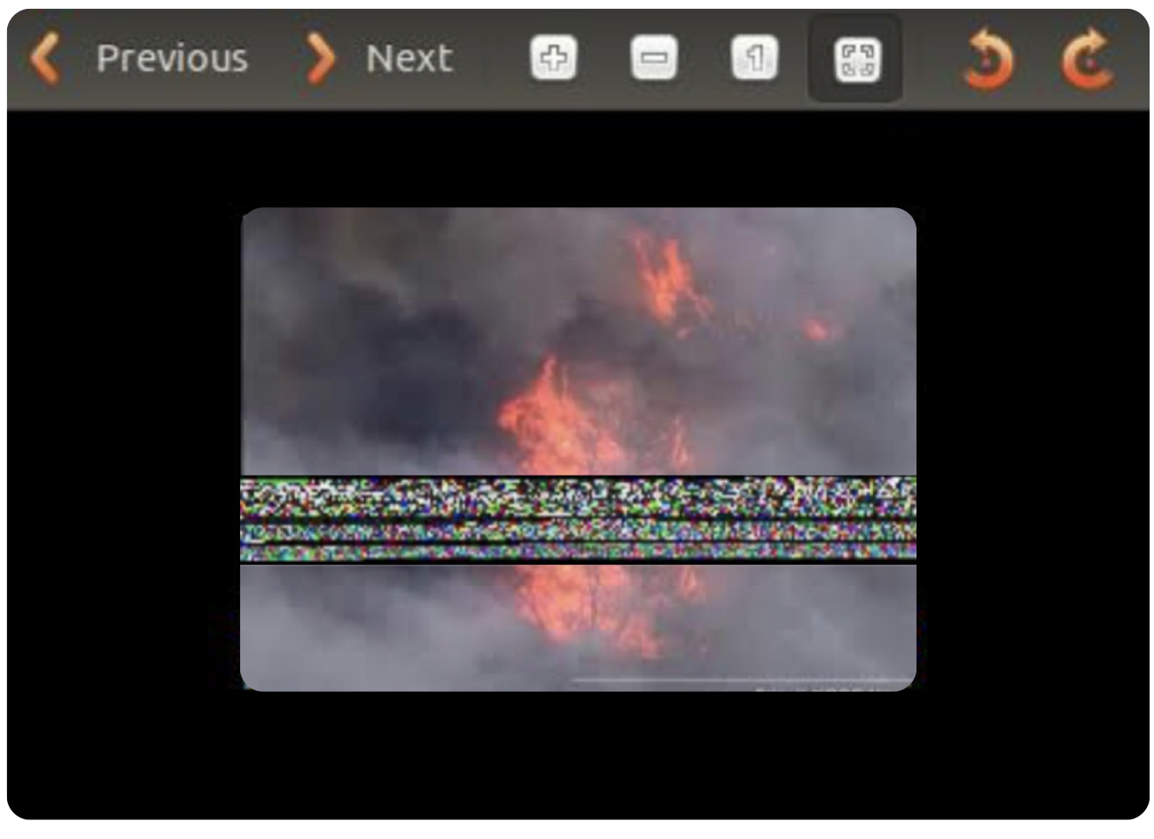
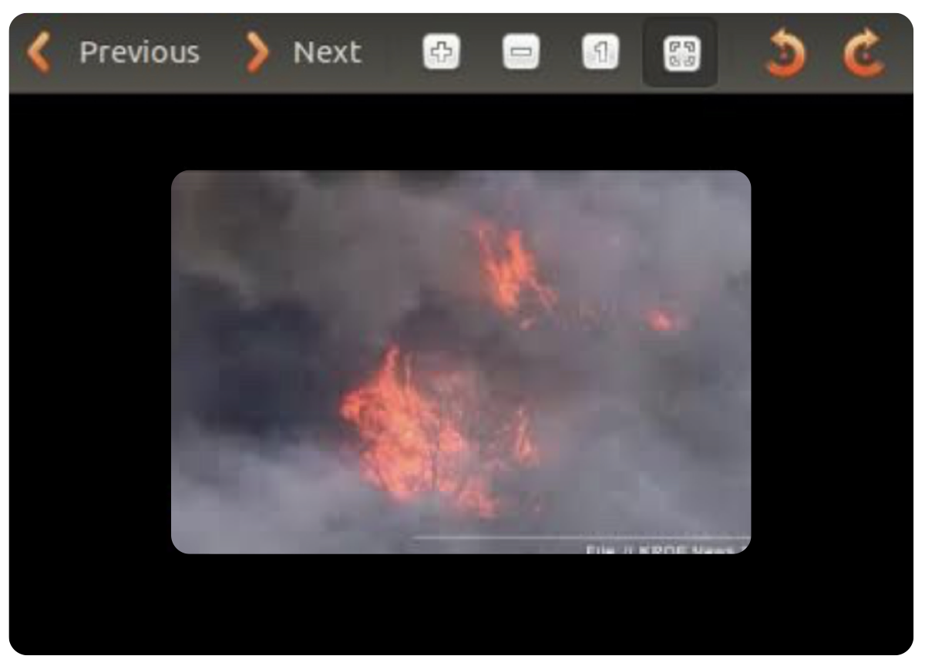
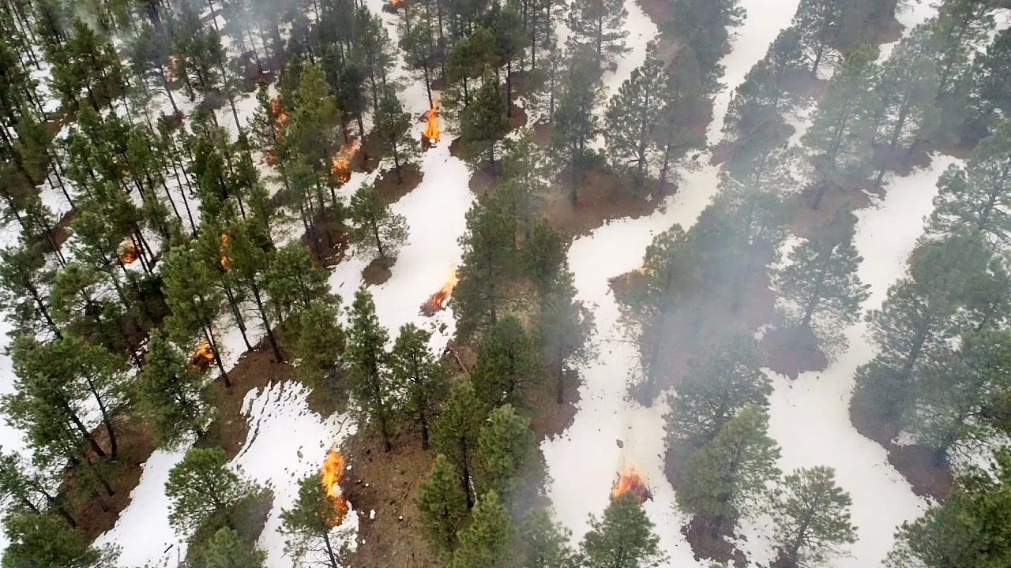
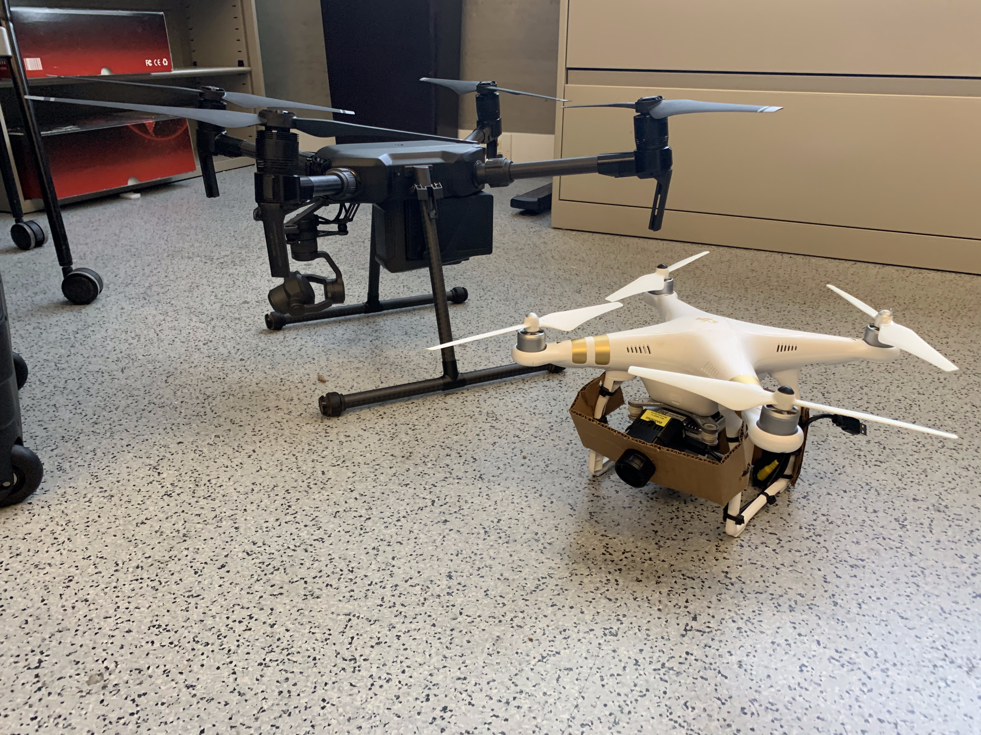
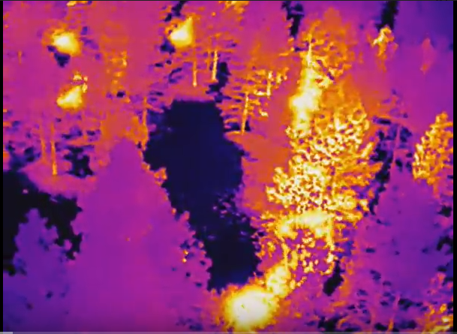
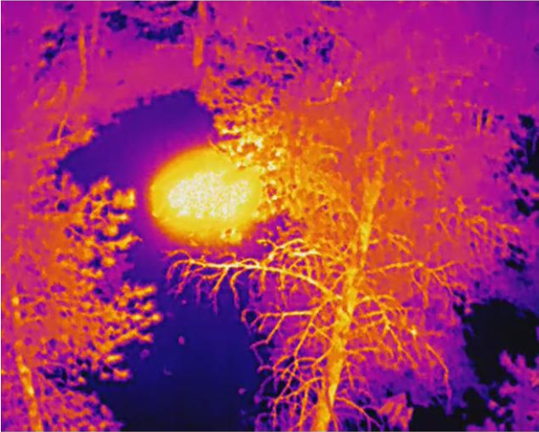
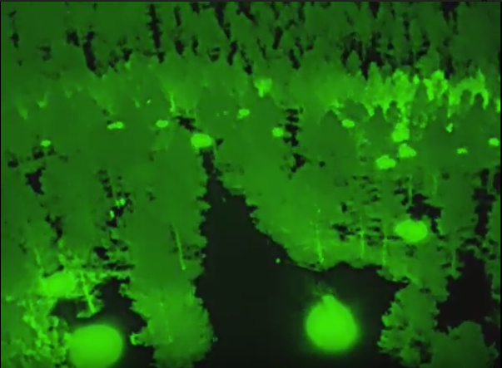
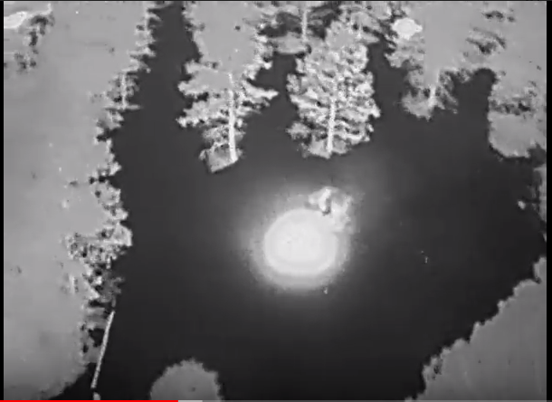
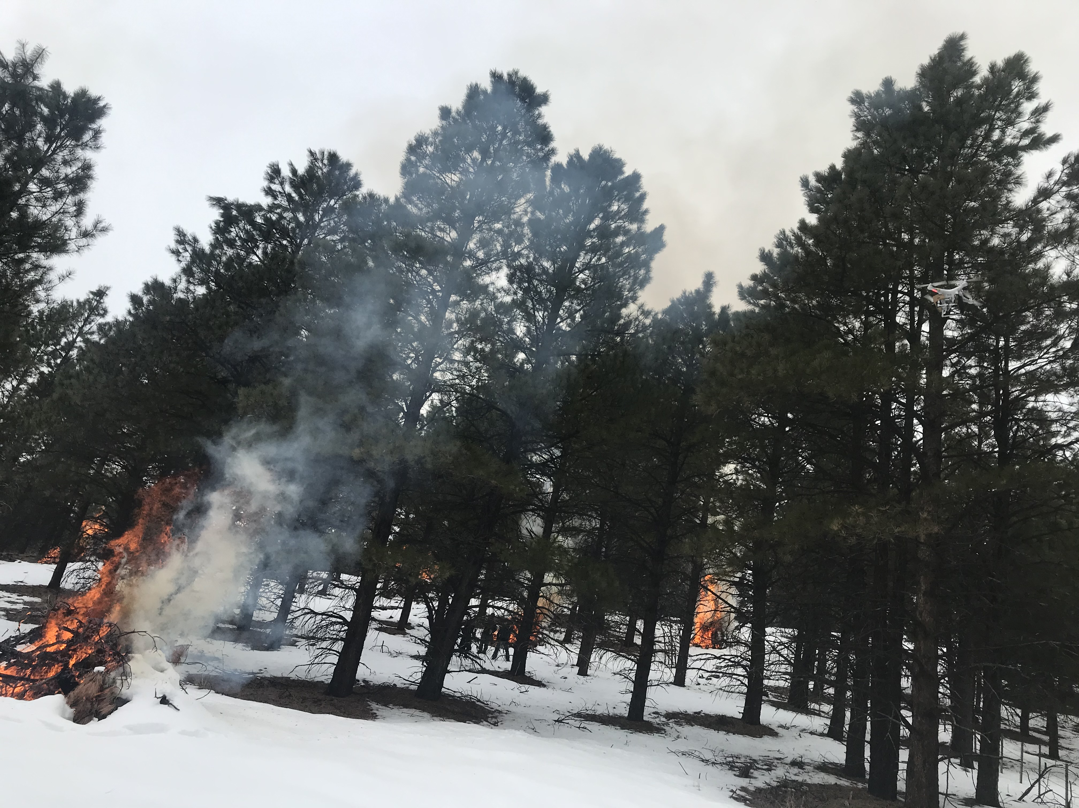
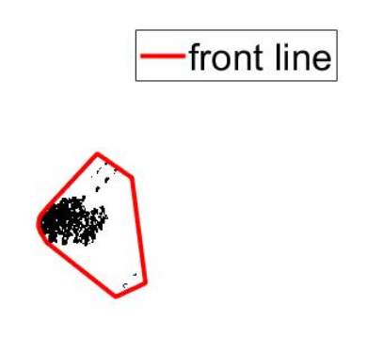
Wildfire Drone
Team members: Haiyu Wu, Yue Zhang, Oshan Wijesooriya, Kun Xiao
Clients: Dr. Fatemeh Afghah, Alireza Shamsoshoara
School of informatics, Computing, and Cyber Systems, Northern Arizona University, Flagstaff, AZ 86011
Abstract
Methods
Successfully transmitted our image data and minimized the multipath and noise distortion by using a CMA equalizer and the FEC method
Results
Due to wildﬁres’ huge destructive impacts on agriculture, food production, wildlife habitats, climate change, and human life, timely discovery of ﬁres enable swift response to ﬁres before they go out of control, in order to minimize the resulting damage and impacts. Our project is trying to combine image processing, wireless communication and UAVs to achieve real-time wildfire monitoring. In order to maximize response times.
Wireless communication
1. The general objective is to perform wireless transfer of image data, in JPG format, using the SDR paradigm.
2. The software portion will be implemented using GNU Radio Companion (GRC). It can be used with external RF hardware to create SDRs, or without hardware, for simulations.
3. The hardware portion will be implemented using two Universal Software Radio Peripherals (USRP).
4. Two modulation schemes, Binary Phase Shift Keying (BPSK) And Quadriphase Phase Shift Keying (QPSK) will be performed in the designed communication system.
Wireless communication
1. Images in JPG format can be transmitted and received by using our simulative functional sequence or the sequence with the hardware portion
2. Successfully transmitted our image data and reduced the multipath and noise distortion by using a CMA equalizer and the FEC method
the image received without correction
the image received after mutiple correction
Image processing
1. Fire identification by using movilenet_V2 lightweight network structure with 17 convolution layers.
2. Transfer learning algorithm
3. Feature based fire segmentation by using RGB
4. Feature based fire segmentation by using binary and curvature filter
Image processing
1. Fire identification accuracy in our dataset was 99.3% for normal images.
2. The identification speed is 0.24s per image.
3. We can segment the fire from the image with a proper range
original
binary and curvature filter
RGB
Conclusion
References
We spent a lot of time collecting the wildfire image dataset and getting the permission of the computers in SICCS building from ITS department. Fortunately, we collected over 3000 images so that we can training the neural network. Moreover, we have designed a wireless communication system which can transmit the image data with reduced distortion and error. We have finished all software parts and the results are great. However, due to the serious coronavirus situation, we are not able to implement our software parts into our hardware. Therefore, theoretically, our theories and code fit all the requirements perfectly except testing them on the hardware.
[1] M. Sandler, A. Howard, M. Zhu, A. Zhmoginov, and L.-C. Chen, “Mobilenetv2: Inverted residuals and linear bottlenecks,” in Proceedings of the IEEE Conference on Computer Vision and Pattern Recognition, 2018, pp. 4510–4520.
[2] Y. Gong and I. F. Sbalzarini, "Curvature Filters Efficiently Reduce Certain Variational Energies," in IEEE Transactions on Image Processing, vol. 26, no. 4, pp. 1786-1798, April 2017.
[3] M. Buettner, D. Wetherall, "A software radio-based UHF RFID reader for PHY/MAC experimentation," in 2011 IEEE International Conference on RFID, pp. 134–146.
[4] L. Huang, K. Zheng, X. Wang, G. Decarreau, "Timing Performance Analysis in an Open Software Radio System," in 2006 First International Conference on Communications and Networking in China.

